Slide 1
Concurrency & Reactive programming in F# … because the future is Immutable!
Writing code that scales to a large number of cores is much easier in the functional style compared to using the typical imperative approach…
Triangle.NET User Group
Notes:
The Future Is Immutable
immutability is going to play a much larger part in the code we write in the future than it has in the past.

Slide 2
Agenda
Concurrency & Terminology
Actor Model
Actor Design Patterns
Event & Reactive Programming
Threading & Parallel Programming
GPGPU Programming
Asynchronous Workflows
Notes:
I will run demo code at the end of each section

Slide 3
Something about me – Riccardo Terrell
Originally from Italy. I moved here ~8 years ago
+/- 15 years in professional programming
C++/VB → Java → .Net C# → C# & F# → ??
Organizer of the DC F# User Group
Software Architect at Microsoft
Passionate in Technology, believer in polyglot programming as a mechanism in finding the right tool for the job
Lucky husband and pug lover

Slide 4
Objectives
Immutability and Isolation are your best friends to write concurrent application
Use natural isolation, the Actor model is a great to enforce coarse-grained isolation through message-passing
Asynchronous Programing in F# is easy and declarative
Concurrency in F# is fully integrated with .NET
Use Actor Model for high scalable computation
Notes:
I will provide a lot of information, but these are the 3 objectives that I wont you to take away.
Immutability and Isolation are your best friends to write concurrent application
Use natural isolation, the Actor model is a great to enforce coarse-grained isolation through message-passing
Asynchronous Programing in F# is easy and declarative
Concurrency in F# is fully integrated with .NET (TPL & Task Lib)
Use Actor Model for high scalable computation

Slide 5
Concurrency & Terminologies
Why we are here?
Because Concurrency is Everywhere
Server-side programming for the web or cloud
Building a responsive graphical user interface
Building a new interactive client application
Performing and compute I/O intensive activity
All to attain better performance
Why do you care about performance?
Because you can measure it
Notes:
Concurrency is everywhere, in the server, in the cloud, in the UI of a client application that requires responsive User Experience
Every programmer want to write high performance and bug free code, but it is not easy.
As programmer is our responsibility, as never before, to leverage the power that our modern computer provide.
We have to write high performance code that scales regardless if the software is running on CPU with 1 or 2 or more cores.
…But Multi-threaded code represents one of the most difficult and error prone code to write and debug

Slide 6
Concurrency & Terminology
Concurrency is the notion of multiple things happening at the same time.
Concurrent: programs with multiple threads of execution, each typically executing different code
Parallel: one or more threads executing simultaneously in order to speed up execution
Asynchronous: programs perform I/O requests that don't complete immediately but that are fulfilled at a later time and where the program issuing the request has to do meaningful work in the meantime
Reactive programming is writing applications in such a way that they respond to events as they occur in real time.
Notes:
I have this slide only because I want to clarify some common terminologies that sometimes are confusing before to procede
Who can tell me the different between parallel and concurrent?
Processes: standard operating system (OS) processes. Each instance of the .NET CLR runs in its own process, processes are typically independent.
Threads: is the smallest sequence of programmed instructions that can be managed independently by the OS. Each .NET process has many threads running within the one process and sharing the same heap
Asynchronous programming aims to separate processing and reduce blocking so that longer-running tasks don’t prevent the system from completing other tasks within the same process. By contrast, parallel processing aims to improve performance by partitioning work into chunks that can be distributed across processors and operated against independently.
Data parallelism. Involves performing a specific action against each value in a sequence by distributing the work effectively across available processing resources. Under the data parallelism model, you specify a sequence along with an action and the TPL determines how to partition the data and distributes the work accordingly
Threads are execution paths of the same process, and the heap actually belongs to the process (and as a result shared by the threads). Each threads just needs its own stack to function as a separate unit of work
. A thread can execute any part of the process code, including parts currently being executed by another thread.

Slide 7

Concurrency
Modern computers come with multiple processors, each equipped with multiple cores, but the single processor is slower than used to be! Moore’s law (http://en.wikipedia.org/wiki/Moore's_law)
… to achieve great performances the application must be leveraging a Concurrent Model
Notes:
One of the main reasons that makes programmers interested in functional programming today is the need for a good concurrency programming models.
Functional programming has out of the box an excellent support for concurrency and parallelism. Because they eliminate mutable state, functional programs are intrinsically thread-safe and easily parallelized
This need comes from the evolution of the hardware toward multicore. Programs no longer benefit very much from A faster CPU. Instead, programs need to be parallelized to take the benefit and leverage of more than one CPUs available in a machine.
Moore’s Law
Predicted in 1965 that transistor density in semiconductor chips would double every 18 months… but there is a problem.. The free lunch is over.

Slide 8

Concurrency
There is a problem…
the free lunch is over
Programs are not doubling in speed every couple of years for free anymore
We need to start writing code to take advantage of many cores
Notes:
So the problem is that “the free lunch is over”!
These days and more and more in the future, computer are shipped with multiple cores, which enable to process several tasks at the same time.
Until now, program languages were design without concurrency in mind, and we write code in a sequential way that execute a single stream of operations.
But Today we’re facing new challenges, we need to write programs that process large data sets and scale to a large number of processors
Currently writing a concurrent application is painful and problematic to take advantage of many cores because of shared memory, locking, and other imperative programming techniques

Slide 9
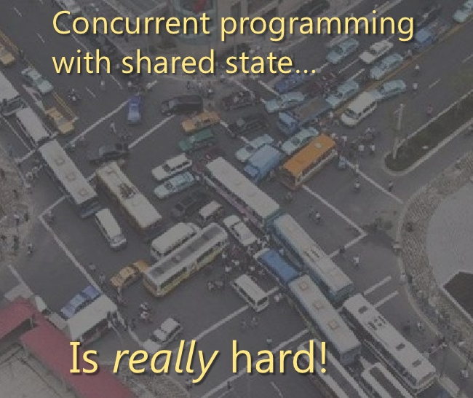
Concurrency… jams to avoid!
Parallel, asynchronous, concurrent, and reactive programs bring many challenges because these programs are nearly always nondeterministic
This makes debugging/testing challenging
Deadlocking
Not easy to program
Concurrency is a double-edged sword
Notes:
It is commonly acknowledged that writing code that handles concurrency is extremely hard. Or I should say, writing concurrent code that is CORRECT is extremely hard! It's very easy to write concurrent code that is buggy; there might be race conditions, or operations might not be atomic, or tasks might be starved or blocked unnecessarily, and these issues are hard to find by looking at the code or using a debugger.
We can program multithreading in almost all the languages today. What’s the problem? Is sharing the state!
Programming multithreaded application in a traditional way is very difficult,
So, you might start to use lock, mutex, semaphore and so on, but how can you tell the lock is in the right place? There is not compiler or debugging tool that can detect a problem with a lock
Locking has a cost.
Locking prevents parallelization.
Locking is very hard to get right
When writing a multithreaded application using the traditional imperative style, we face problems:
It’s difficult to turn existing sequential code into parallel code, because we have to modify large portions of the codebase to use threads explicitly
Using shared state and locks is difficult. You have to carefully consider how to use locks to avoid race conditions and deadlocks but leave enough space for parallel execution.
two or more different threads can change the same data at the same time, it’s difficult to guarantee that the execution will leave the data in a valid state, and testing is nearly impossible
Direct thread manipulation has historically been the way developers attempted to achieve responsive client applications, parallelized algorithms and scalable servers. Yet such techniques have also been the way developers historically achieved deadlocks, livelocks, lock convoys, two-step dances, race conditions, oversubscription and a host of other undesirable warts on applications.
A race condition is when you have two threads trying to read or write the same reference at the same time. If two threads are writing a value, the last one wins, and the first write operation is lost forever. Similarly, if one thread reads a value and the other immediately overwrites that value, then the first thread’s data is out of date and potentially invalid.”
Deadlocks are when you want to access a resource that is locked by another thread, but that other thread won’t let up until you release a resource that you have locked. ”

Slide 10

F# advances in concurrency programming
Thanks to the immutability (and isolation), we avoid introducing race conditions and we can write lock-free code.
A function call never changes data, it only returns new data
Referential Transparency
Higher-order function and Lazy Evaluation (not explicit)
Asynchronous Workflow
Actor-Based concurrency model – MP (Isolation)
Notes:
The solution is to remove the problem at the SOURCE and write functions that bring on the table the concept of immutability and isolation
How F# and functional programming in general can help?
With Isolation and Immutability
Isolation and Immutability are the keys to build “lock free” application.
But concurrency is not coming for free, is not because we are using functional programming that “auto-magically” the code will run concurrent leveraging all the cores available.
And F# can provides several awesome tools for building high performance application in a simple and effective way.
I will talk about the async workflow, the actor model
Referntial Transparency
“side effect” is anything that reads or writes mutable state. Input/output is a prominent example of a side effect
Functional programming gives us the answers:
Thanks to the immutability, we avoid introducing race conditions and we can write lock-free code. We can immediately see which parts of the program are independent, and we can modify the program to run those tasks in parallel
When using a declarative programming style we can introduce parallelism into existing code. We can replace a few primitives that specify how to combine commands with a version that executes commands in parallel
Actor Model (Erlang, Scala, F#, Clojure… C# DataFlow??)

Slide 11

Immutability
Immutability is very important characteristic of FP but mostly is about transformation of state… … Immutable data forces you to use a “transformational” approach
When you’re writing programs using immutable types, the only “thing a method can do is return a result, it can’t modify the state of any objects
Immutable data makes the code predictable is easier to work
Prevent Bugs
Concurrency is much simpler, as you don’t have to worry about using locks to avoid update conflicts
Automatic thread-safe, controlling mutable state in concurrency is very hard
Notes:
Immutability gives us enormous power to reason about behavior of programs and potentially it is able to prove that a program is correct.
FP encourages using transformations rather than mutations. A transformation doesn't modify the object. It just creates a new object and keeping the original object intact. Which means that the object will be always in one single state and for this reason it's safe to use it WITHOUT DOING EXTRA CHECKING.
When a program is designed using a transformation approach, the result tends to be more SCALABLE because the the problem about SHARING STATE doesn’t EXIST… and almost bug free
- ($ money analogy) 10 dollars to split.. So you transform the 10$ in two 5$ instead that mutate it
Immutability gives us the confidence that our variables will not be changing and that our objects will be the same no matter what function we will run aganst!
Immutable data makes the code predictable and almost bug free, you will be surprise and amazed that writing code using this approach your program will be almost bug free

Slide 12
Referential Transparency
A function is said to be referential transparency if it can be replaced with is value without changing the behavior of a program.
The importance of referential transparency are:
It can help in proving correctness
It simplifies an algorithm
lazy evaluation
Efficiency with caching, can be memoized (transformed into equivalent functions which cache results)
Parallelization, I can change the order of execution without jeopardize the behavior
Notes:
referential transparency is a function that can be replaced with is value without changing the behavior of a program, because his returns values depends only on the input values that are passed.
This concept can help in proving correctness, help to memoized (cache), and parallelize the code

Slide 13
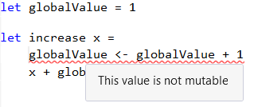
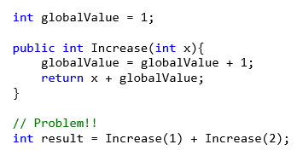
Referential Transparency
A function is said to be referential transparency if it can be replaced with is value without changing the behavior of a program.
Increase method without Referential Transparency
Notes:
As an example, let's use two functions, one which is referentially opaque, and the other which is referentially transparent:
globalValue = 0;
let globalValue = 1 // mutable
let increase x =
globalValue <- globalValue + 1
x + globalValue

Slide 14
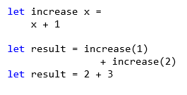
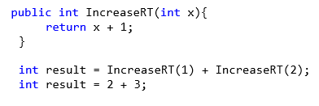
Referential Transparency
A function is said to be referential transparency if it can be replaced with is value without changing the behavior of a program.
Increase method with Referential Transparency

Slide 15
Event &
Reactive model

Slide 16
Event & Reactive Programming in F#
Events are used to notify that something happened in the application, is something you can listen to by registering a callback with the event
Events are first class composable entities much like object and functions, I can pass them as arguments to functions and returned as results
Events use combinators to take an existing event and transform it into a new event-stream in a compositional way
Event-Streams can be treats as a collection (IEnumerable)
Notes:
Almost every program has to handle events, whether it is clicks in the user interface or listening to sockets in a server
So let think about Events as a reaction to a change of state
Event based programming is a well understood concept in the .NET ecosystem, but F# brings the concept of composition, the events are composable
In F# events are first class citizen, this means that you can write a function that takes an event as an argument and returns an event.
In fact there are functions, called COMBINATORS, in the “Event” module that are taking events and transform them or compose them in new events.
The idea is to turn a series of events into an ”EVENT STREAM". Event streams then become quite like IEnumerables, so that they can be filtered, mapped, split and combined.

Slide 17
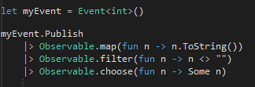
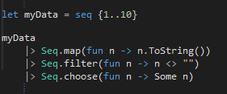
Event Combinators
The biggest benefit of using higher-order functions for events is that we can express the flow in a Declarative way
What to do with received data using event combinators
Use functions for working with event values
Observalbe Module Seq Module
Notes:
Combinators are great for a declarative way to program against events
As you can see The Event module provides functions that look like we are programing against sequences
What to do with the received data VS How to react with the received data
Subscribers add event handlers which are called when the event is triggered.
The F# language treats .NET events as values of type IEvent<'T> and provides a rich programming model built on top of events. This interface inherits from the IObservable<'T> type that is available in Microsoft® .NET 4.0 and is used by other libraries such as Reactive Extensions (Rx).

Slide 18
Event map & filter & add
Filter and trigger events in specific circumstances with Event.filter
Create a new event that carries a different type of value with Event.map
Register event with Event.add
Event.map : ('T -> 'R) -> IEvent<'T> -> IEvent<'R>
Event.filter : ('T -> bool) -> IEvent<'T> -> IEvent<'T>
Event.add : ('T -> unit) -> IEvent<'Del,'T> -> unit
Notes:
This is a peek of the functions in the Event module
MAP EVENT T -> to -> R
See the signature,

Slide 19
Event merge & scan
Merging events with Event.merge
Triggered whenever first or second event occurs
Note that the carried values must have same type
Creating stateful events with Event.scan
State is recalculated each time event occurs
Triggered with new state after recalculation
IEvent<'T> -> IEvent<'T> -> IEvent<'T>
('St -> 'T -> 'St) -> 'St -> IEvent<'T> -> IEvent<'St>

Slide 20
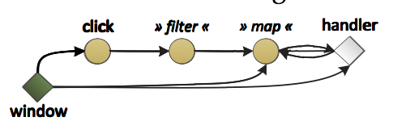
Event are Observable… almost
Memory leak ☹
IEvent does not support removing event handlers (RemoveHandler on the resulting event, it leaves some handlers attached… leak!)
Observable is able to remove handlers - IDisposable
Notes:
A problem with the Event composition, is that they are attached to the source of event and they don’t provide a way to unsubscribe.
And this can lead to Memory leak issues. Instead, in F# we can use the Observable module to construct events using combinators, and the observable will provide back an IDisposable that can be used to remove all handlers resolving the Memory issue.
In general it is recommended to use the Observable vs Events

Slide 21
Observable in F#
Event<‘T> interface inherits from IObservable<‘T>
We can use the same standard F# Events functions for working with Observable
Observable.filter : ('T -> bool) -> IObservable<'T> -> IObservable<'T>
Observable.map : ('T -> 'R) -> IObservable<'T> -> IObservable<'R>
Observable.add : ('T -> unit) -> IObservable<'T> -> unit
Observable.merge : IObservable<'T> -> IObservable<'T> -> IObservable<'T>
Observable.subscribe : IObservable<'T> -> IDisposable
Notes:
These are few function from the Observable module, as you can see overlap the functions that are part of the Event module.
The subscribe function returns the IDisposable

Slide 22
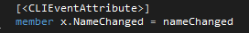
Accessing F# events from .NET languages
Events in F# are values of type
Event<‘T> implementation for the IEvent<'T>
Event<‘Delegate,’Args> implementation for the delegate type following .NET standard
Create the events using new Event<DelegateType, Args> instead of new Event<Args>
CLIEventAttribute instructs
F# to generate .NET event (+= & -=)
Notes:
To access the F# Events from other .Net languages just add the attribute CLIEvent

Slide 23



Slide 24
ASYNC

Slide 25
Asynchronous Workflows
Software is often I/O-bound, it provides notable performance benefits
Connecting to the Database
Leveraging web services
Working with data on disk
Network and disk speeds increasing slower
Not Easy to predict when the operation will complete (no-deterministic)
Notes:
Asynchronous Workflow, A workflow, is a computation expression, are any body familiar with computation expression?
computation expression is a mechanism that enables to implement and execute a controlled series of expression as an evaluation of steps.
So Asynchronous workflows are basically a way of writing continuation passing programs in a nice way, in a linear syntax.
Asynchronous code is normally used for I/O operation such as operate with the file system, call DB and so on.
But in F#, the Async workflow is smart enough to understand the task that we executing and decide from which thread pool to pick a thread
~ Amdahl’s law (wikipedia.org/wiki/Amdahl's_law) shows us that the performance improvement is limited by the slowest portion of the execution. In many cases, there’s an increasing percentage of time spent waiting on data from I/O such as disks

Slide 26

Classic Asynchronous programming
We’re used to writing code linearly
Asynchronous programming requires decoupling Begin from End
Very difficult to:
Combine multiple asynchronous operations
Deal with exceptions, cancellation and transaction
Notes:
We used to write code in a synchronous way because is natural and simple to write linear code that that represents each step of our program as a sequence of operations.
It is more complicated to write Async code using the traditional APM model, because we are forced to separate the action which begins the operation and the action that terminate the operation…. which runs when the operation is completed
In fact, using this model is likely that the tread that start the operation is not the same that will complete the same operation, and this could generate few problems. (we will see shortly)
However in F#, using the Async workflow it becomes easy to write asynchronous code that looks like a sequential one

Slide 27
Synchronous Programming
Synchronous I/O or user-interface code
Blocks thread while waiting
Does not scale
Blocking user interface – when run on GUI thread
Simple to write – loops, exception handling etc
let wc = new WebClient()
let data = wc.DownloadData(url)
outputStream.Write(data, 0, data.Length)
Notes:
This is an example of a traditional Synchronous code, because the linearity of the approach, it is very simple and most developer feels very confortable.
But there are several downsides: the code doesn’t scale, blocking UI, and we are NOT leveraging all the cores available.

Slide 28
Classic Asynchronous Programming
let wc = new WebClient()
wc.DownloadDataCompleted.Add(fun e ->
outputStream.BeginWrite( e.Result, 0, e.Result.Length,
(fun ar -> outputStream.EndRead(ar)), null))
wc.DownloadDataAsync(url)
Writing the code that performs asynchronous operations is difficult to implement using the current techniques
Two different programming models
BeginFoo & EndFoo methods
FooCompleted & FooAsync using events
Operation completes in different scope
Notes:
The APM model is a pattern that divides asynchronous operations into two methods, Begin and End. When Begin is called, the operation starts asynchronously, and when the operation completes, a provided callback is executed in the End Operation, which will retrieve the result of the asynchronous computation
One big problem with this model is that the Operation completes in different scope.
So, the questions are : Where should I put a try-catch to handle exception? what about if the operation requires a transaction scope?

Slide 29
Anatomy of Asynchronous Workflows
let getLength url = async {
let wc = new WebClient()
let! data = wc.AsyncDownloadString(url)
return data.Length }
Easy transition from synchronous
Wrap in asynchronous workflow with the async keyword, use let! for async calls and add return
No need of explicit callback
Easy to debug
Supports loops, recursion, exceptions, cancellation, resource management
Operation complete in the same scope
Notes:
In F# Asynchronous Workflows allow us to write code that look sequential and that run without block the thread.
There are several benefits,
there is not need of any callback, the operation complete in the same scope, I can wrap it in a try-catch,
I can cancel the operation easily, but mostly it is easy to debug.
The change to run this behavior asynchronously didn’t require much additional code, but perhaps just as importantly, it didn’t require a change in the way the code was structured. When you write the code the first time, you don’t have to worry about designing it to possibly run asynchronously in the future. You’re free to write synchronous code when prototyping and then easily convert it to async when it becomes necessary. This flexibility can save you hours of development time and make your clients much happier when you’re able to respond to change more rapidly.

Slide 30
Anatomy of Asynchronous Workflows
let openFileAsynchronous : Async<unit>
async { use fs = new FileStream(@"C:\Program Files\..., …)
let data = Array.create (int fs.Length) 0uy
let! bytesRead = fs.AsyncRead(data, 0, data.Length)
do printfn "Read Bytes: %i, First bytes were:
%i %i %i ..." bytesRead data.[1] data.[2] data.[3] }
Async defines a block of code we would like to run asynchronously
We use let! instead of let
let! binds asynchronously, the computation in the async block waits until the let! completes
While it is waiting it does not block
No program or OS thread is blocked
Notes:
In the asynchronous workflows in F# the code is wrapped in an async block and doesn’t execute immediately.
Rather, the computation is returning an Async<'T> , which you can think of as an asynchronous operation that will eventually return an instance of 'T.

Slide 31
Anatomy of Asynchronous Workflows
async { let! image = AsyncRead ”bugghina.jpg"
let image2 = f image
do! AsyncWrite image2 ”dog.jpg"
do printfn "done!"
return image2 }
async.Delay(fun () ->
async.Bind(ReadAsync ”bugghina.jpg", (fun image ->
let image2 = f image
async.Bind(writeAsync ”dog.jpg",(fun () ->
printfn "done!"
async.Return())))))
Notes:
The code written using a async workflow is translated into an expression that uses the primitives provided by the computation builder.
this means that the let! (BANG) construct is translated into a call to async.Bind, and return is translated into async.Return and so on.
So the let! (BANG) or return are just syntactic sugar to make even easier to write Async code that look sequential

Slide 32
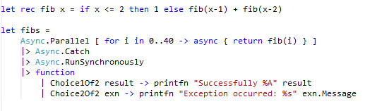
Async – Exceptions & Parallel
Creates an asynchronous computation that executes all the given asynchronous computations queueing each as work items and using a fork/join pattern.
Notes:
If an exception from an async workflow is not caught the exception bubble up and eventually bring down the whole process!
Async module support Error handling out of the box.
To catch unhandled exceptions from async workflows, you can use Async.Catch or of course use a try-cacth block
Tasks that are run using Async.RunSynchronously report any failure back to the controlling thread as an exception.

Slide 33
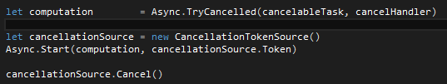
Async - Cancellation
The Asynchronous workflows can be cancelled!
Cancelling an async workflow is a request …
The task does not immediately terminate
Async.TryCancelled()
CancellationToken()
Notes:
The possibility to cancel task or a sequence of tasks is very important when dealing with asynchronous operations. The Async module use the same approach as TPL library, it uses the CancellationToken
So when we start the workflow, we pass this token to the Async.Start operation, and when the user requests cancellation we call the Cancel method of the token source to stop our Async operation.

Slide 34
Async - StartWithContinuations
What do we do if our parallel code throws an exception?
What do we do if we need to cancel our parallel jobs?
How can we safely update the user with correct information once we have our results?
If we want more control over what happens when our async completes (or fails) we use Async.StartWithContinuations
let asyncOp (label:System.Windows.Forms.Label) filename =
Async.StartWithContinuations(
async { use outputFile = System.IO.File.Create(filename)
do! outputFile.AsyncWrite(bufferData) },
(fun result -> label.Text <- "Operation completed."),
(fun error -> label.Text <- "Operation failed."),
(fun cancel -> label.Text <- "Operation canceled."))
Notes:
This is my favorite function of the Async module.
Async.StartWithContinuations takes the Async operation and three other functions to determine the behavior when the operation completes. So beside the completation function we have the functions to handle if the operation has been cancelled or failed.
Async.StartWithContinuations has the important property that if the async is started on the GUI thread, then the completion function uses the current SYNCHRONIZATION CONTEXT to dispatch the completed function. This makes it safe to update the results in the UI directly without marshal the current thread.

Slide 35
Async – Limitations
Executing code in parallel there are numerous factors to take into account
No in control of the number of processor cores run simultaneally
It doesn’t consider the existing CPU workload
There is no throttling of executing threads to ensure an optimal usage
For CPU-level parallelism, use the .NET Task Parallel Library
Notes:
There are some limitation when perform async operation:
There is not control of the number of cores that can run simultanealy and there is not knowledge of the current CPU usage and payload
The F# asynchronous workflows is a lightweight wrapper on top of the thread pool, using it won’t guarantee that you will maximize performance.
It is recommended to use the .NET Task Parallel Library For CPU parallelism.
~~~ cache coherence refers to.

Slide 37
Actor Model

Slide 38
Concurrent Model Programming
IMMUTABILITY +
ISOLATION +
DECLARATIVE PROGRAMMING =
------------------------------------------------
BEST CONCURRENT MODEL PROGRAMMING
An Agent is an independent computational entity which contains a queue, and receives and processes messages
It provides immutability and isolation
(it enforces coarse-grained isolation through message-passing)
Notes:
Recipe – Secret sauce!!
F# has borrowed the message-processing mechanism from Erlang.
The Actor model provides immutability and isolation which are the more important characteristic to write lock and bug free concurrent program
The Isolation is forced through message passing
Mailboxes are used in programming models that don't use locks, it is built around asynchronous processing, locks unnecessary.
There are several similarity with the agents in Erlang, but unlike the Erlang ones, in F# Agents do not work across process boundaries, only in the same process.
And the messages are not persistent. If your process crashes, the messages are lost.
My view on this matter may be a controversial one. Immutability is an important foundational tool in the toolkit for building concurrent – in addition to reliable and predictable – software. But it is not the only one that matters. Making all your data immutable isn’t going to instantly lead to a massively scalable program. Natural isolation is also critically important, perhaps more so.
There is an open source library that is trying to bridge the gap, I have few sample later.

Slide 39
What are F# Agents?
The Actor model is a model of concurrent computation using actors which is characterized by dynamic creation of actors, inclusion of actor addresses in messages, and interaction only through direct asynchronous message passing with no restriction on message arrival order. [Wikipedia]
Notes:
This is the Wikipedia definition
The actor model is a general-purpose concurrent programming model with a wide applicability, not only does it provide support for concurrency, but it also provides distribution and error detection.
You can think of an agent as an entity that hides a message queue, and that it reacts when a message arrives.
For example an agent could have an internal loop in the body that asynchronously waits for messages and then processes them one by one.

Slide 40
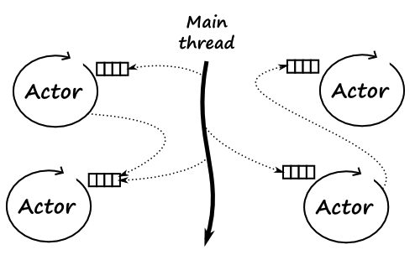
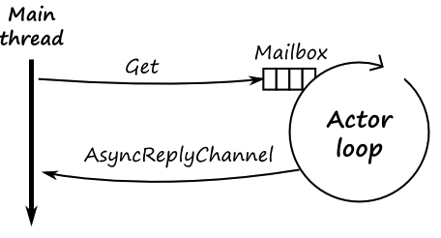
What are F# Agents?
Notes:
One of the keys to successful agent programming in F# is isolation. Isolation means that resources exist which “belong” to a specific agent, and are not accessed by other agents. This means isolated state is protected from concurrent access and data races.
Conceptually an Agent has its own “thread” of execution, and it is also both asynchronous and parallel and BUFFEREDl. This has two implications:
By being asynchronous, the agents are lightweight, because they do not block threads while waiting for a message. And As a result, it is possible to use hundreds of thousands of agents in a single application without any impact in the memory footprint
And being executed in parallel, the performance of a agent-based application scales with the number of cores

Slide 41
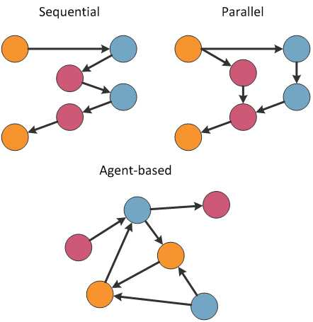
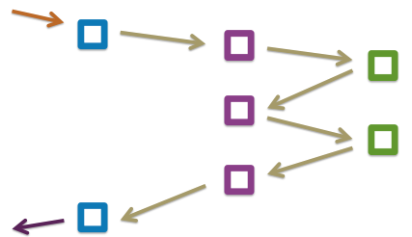
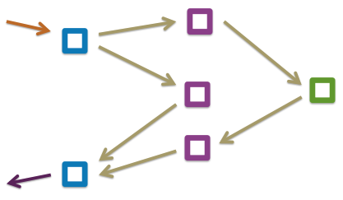
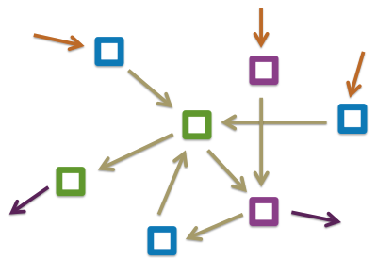
Agent Model
What does a system of actors look like?
Notes:
A system written using multiple agent can benefit from multicore system, because all Agent can run in parallel
Sequential is just a single flow, the application has one entry and one output
Parallel system use multiple threads, the control flow can be forked and then joined to perform in parallel
Agent-Based the system is constructed by several agents, and each solve an aspect of the problem.
agents in a concurrent system are often connected with a large number of other agents. an agent can references other agents and send messages to them directly.
A server-side applications need to handle a large number of requests in parallel. A server-side application that runs efficiently on modern systems needs to exploit the power of multicore CPUs. The agent-based programming model in Using Message Passing is concurrent but it requires architecture that differs from the usual sequential style
A concurrent system usually needs agents that implement some application-specific behavior (such as communication with the stock exchange or a calculation) and agents that implement some general behavior (such as queuing of work or grouping of items).

Slide 42

How does an Agent look?
What does a system of actors look like?
Notes:
Example with a Metro System
I like to call the communication between Agents as a shared-nothing asynchronous message passing system

Slide 43
What Agent can do? Agents perform actions
Buffering Messages
Asynchronous Execution
Determine what to do with income message
Change its behavior for the next messages
Communicate and notify other actors and create more Agents
Send reply to the sender of a message
Notify other Agents
Do calculations and update state
Notes:
This is a list of what and Agent can do
To me, the two most important features of an agent are that the messages are sent asynchronously, and they are placed in a mailbox
Buffering of messages mean that If you send multiple messages to the agent, none of the messages will get lost. The messages are buffered
Asynchronous execution mean that The waiting for a message in the agent’s body is asynchronous, and so If you create hundreds of agents, the process will not use hundreds of threads.
F# has a built-in agent class called MailboxProcessor. These agents are very lightweight compared with threads - you can instantiate tens of thousands of them at the same time.

Slide 44
Declaring messages
Agents handle multiple messages
Message type using discriminated union
Safety guarantees
Agent will be able to handle all messages
type CacheMessage<'T> =
| Add of string * 'T
| Get of string * AsyncReplyChannel<option<'T>>
| Reset
Notes:
This is an example how to use a discriminated union to declare a message for an Agent.

Slide 45
Scan - TryScan
Actor can be in a state in which wait for specific Message(s) and Scan (or TryScan) a message by looking through messages in arrival
let agent = Agent.Start(fun agent ->
(*...*)
let! msg = agent.Scan(fun Resume -> reurn! ...
(*...*)
Notes:
It's possible for an agent to end up in a state in which it's not INTERESTED, in all messages that may appear in a mailbox but only in a portion / subset of them.
Scan and TryScan accept a function and returns a computation that filter all elements in the message queue and only the matched messages are removed from the queue leaving the other still available
This provides great flexibility with how you process messages, but you need to be careful of what you’re posting to the agent because messages that are not processed by Scan remain in the queue. As the queue size increases we can quickly run into performance issues using this approach
So, just be careful
Scanning for messages does offer some flexibility with how you process messages, but you need to be mindful of what you’re posting to the agent because messages not processed by Scan remain in the queue.
As the queue size increases, scans will take longer to complete, so you can quickly run into performance issues using this approach if you’re not careful

Slide 46
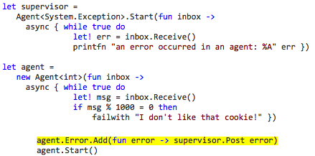
Error Handling
Notes:
We all know mistakes happen. A good error detection is essential in agent-based programming.
The F# Agent model provides an Error handling out of the box.
In this case, the error is shutting down the agent where the exception is raised but no the entire process.
It is a common pattern to have an Agent that act as supervisor that detects the errors from other Agents and react accordingly… may be spawn new agent

Slide 47
Agent Patterns

Slide 48
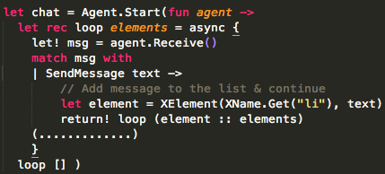
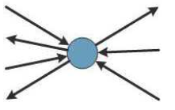
Agent-based Patterns
Worker Agent
useful when the application needs to run some stateful computations on a shared state
Notes:
We can use few patterns for organizing agents when writing a certain kind of applications and a concurrent application can be also composed by using multiple patterns at the same time.
In this slide, The Worker agent, is the basic and classic one, is when a single agent does some work in background, the state is protected by the agent and the worker agent can be also safely accessed from multiple threads.
For Example a chat system.

Slide 49
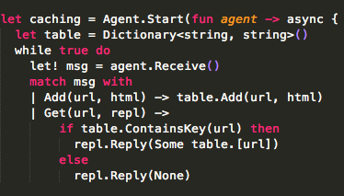
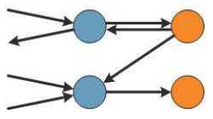
Agent-based Patterns
Layered Agent
is useful when we need to perform some pre-processing or checking before calling another agent to do the actual work
Notes:
The Layered pattern is when an agent uses other agents from lower level, for instance the program communicates with the first layer of agents, which then sends commands to the second layer of agents to do further work
for example, to cache results or handle failures.

Slide 50
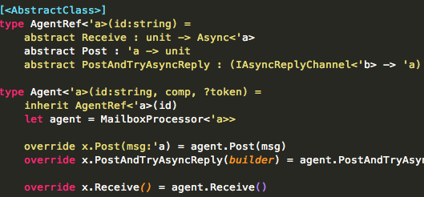
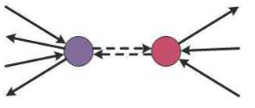
Agent-based Patterns
Proxy Agent
is useful when the actual agent that implements the functionality cannot be directly accessed or needs to be protected in some way
Notes:
In the Proxy Agent, the messages are sent to a proxy agent instead of the actual agent.
The two agents have the same interface and accept the same type of messages, and the proxy agent just forwards the message to the actual agent
This pattern is useful for example when implementing agent-based communication over the network.

Slide 51
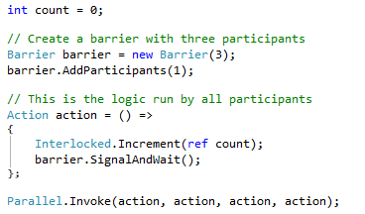

BarrierAsync - .Net Barrier
Notes:
A barrier is a synchronization system that allows work-items to coordinate their use, it enables multiple tasks to cooperate work in parallel through multiple phases.
In .NET 4.0 have been introduced a the barrier object in the System.Threding, which blocks a number of threads until they have all reached the same point.

Slide 52
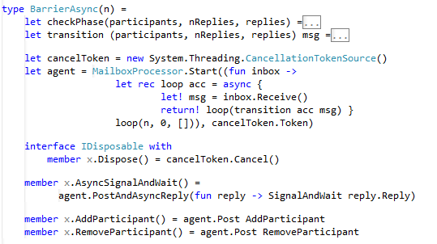
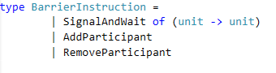
BarrierAsync – Async WF
Notes:
BarrierAsync is an asynchronous version of barrier that provides analogous signature, like the method AsyncSignalAndWait that suspends an asynchronous workflow until the barrier rolls.
Been an asynchronous implementation, the most important advantage of this barrier is the ability to synchronize computations asynchronously without blocking any threads.
This implementation instead of using locks as the .NET version does, we are using a message passing model (Agent).
~~ A barrier is a synchronization mechanism that allows work-items to coordinate their use of local memory. If one work-item in a work-group executes barrier, then all work-items in that work-group must execute the same barrier before any of them can proceed beyond that point

Slide 53
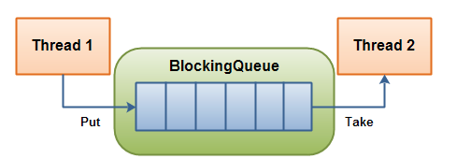
Async-BoundedQueue
Notes:
Why do we need a blocking queue?
Let think of a Producer and consumer scenario, the primary issue is that the producer and consumer may not run at the same speed.
if the producer runs faster than the consumer, the queue will get larger and larger.
A solution to this problem is to use a bounded queue.
Using a blocking queue the producer will be able to get ahead of the consumer, but not too far.
The AsyncBoudedQueue implements asynchronous operations to queue and dequeue items, and both the producers and consumers cooperate and suspend themselves until the capacity of the data are available to satisfy their request.
The MailboxProcessor in the F# uses an UNbounded queues that can grow and grow, this mean that the queue in a consumer can grow without limit if its producers overwhelm it with data.

Slide 54
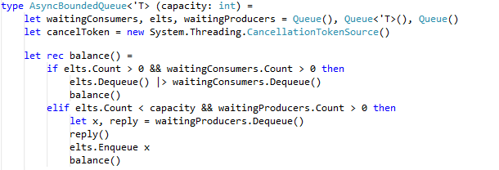
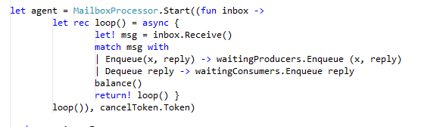
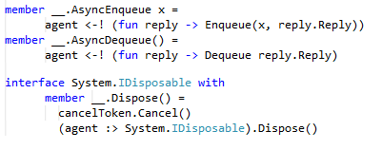
Async-BoundedQueue
Notes:
The implementation of the asynchronous bounded queue begins a constructor that accepts the capacity of the bounded queue.
The bounded queue is composed of three internal queues.
The first is a queue of reply functions for each consumer waiting to dequeue an element.
The second is the current queue of elements.
The third is a queue of elements of reply functions for each producer waiting to enqueue an element.
The balance function shuffles as many elements through the queue as possible
-> 1) The asynchronous agent wait in an infinite loop to receive the AsyncEnqueue and AsyncDequeue messages

Slide 55
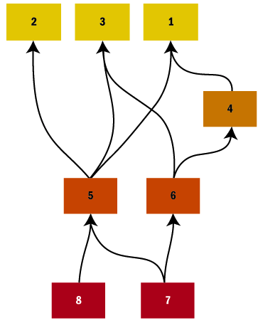
Directed Acyclic Graph
Wiki
DAG is a direct graph with no directed cycles.
It is formed by a collection of vertices and direct edges, each edge connecting of vertex to another, such that there is no way to start at some vertex V and follow a sequence of edges that eventually loops back to V again.
Notes:
Direct Acyclic Graph, Let consider a system where multiple dependent components need to be executed in parallel, a common approach is to model the dependencies as a graph.
Each component is represented by a node, and each dependency is represented by a directed edge between the two nodes sharing the dependency.
It is like a pipeline processing where each step could have one or more steps that could run in parallel and that they all need to complete atomically as a single unit before to pass to the next step.

Slide 56
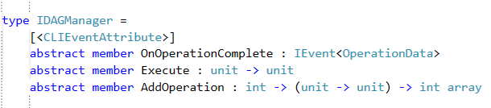
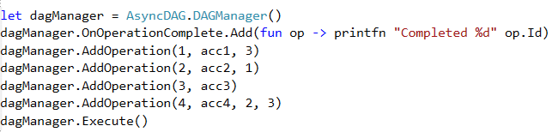
Directed Acyclic Graph
Notes:
This is a simple implementation of a DAG, without any dependency checking, It is just for demo purpose, but I am currently working in a more sophisticated one with checking and where the operation could return a value that could be pass to the next operation and so. It is on github and if anybody would like to help is more then welcome… It is fun stuff
The main entry point is the AddOperation function, which accepts a unique ID that represents an operation and the function to be executed for that operation, and a set of dependencies that this operation relies to. If an operation has no dependencies, the parameter array will be empty.
The Execute method kicks off the process and waits for all of the operations to complete

Slide 57
Pipeline Processing
Pipeline according to Wikipedia:
A pipeline is a set of data processing elements connected in series, so that the output of one element is the input of the next one. The elements of a pipeline are often executed in parallel or in time-sliced fashion; in that case, some amount of buffer storage is often inserted between elements
Notes:
The Pipeline processing is a Step-by-step processing
The pipeline processing pattern is useful when you want to process data in multiple steps. The idea is that inputs are sent to the first agent of the pipeline, this agent does the first step of the processing and sends the result to the second agent in the pipeline, and so on until a final result is calculated.
If used correctly then pipeline can increase the overall throughput of a system, it provides a way to balance the sequential processing…. that reduce performance and the parallel processing… which may have large overhead.

Slide 58
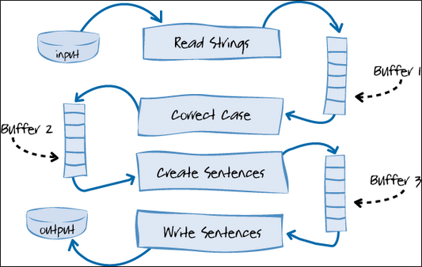
Pipeline Processing
Values processed in multiple steps
Worker takes value, processes it, and sends it
Worker is blocked when source is empty
Worker is blocked when target is full
Steps of the pipeline run in parallel
Notes:
To implement a pipeline pattern we can leverage the async Bounded Queue and think of each step as an independent producer consumer.
In fact each stage is asynchronous and self contained… and is connected to the next stage.
The reason to use the a bounded blocking queue is to limit the amount of payloads that are waiting to be processed

Slide 59
Map >> Reduce
Map Function written by the user to take an input pair and produce a result of intermediate key/value pairs. The intermediate values are then grouped with the same intermediate key and passed to the Reduce function.
Reduce Function also written by the user to take the intermediate key and sequence of values for that key. The sequence of values are then merged to produce a possibly smaller set of values. Zero or one output value is produced per our Reduce function invocation. In order to manage memory, an iterator is used for potentially large data sets.
Notes:
Of course, I could not forget about the Map Reduce… we are in Silicon Valley after all,
This is just some wikipedia terminologies

Slide 60
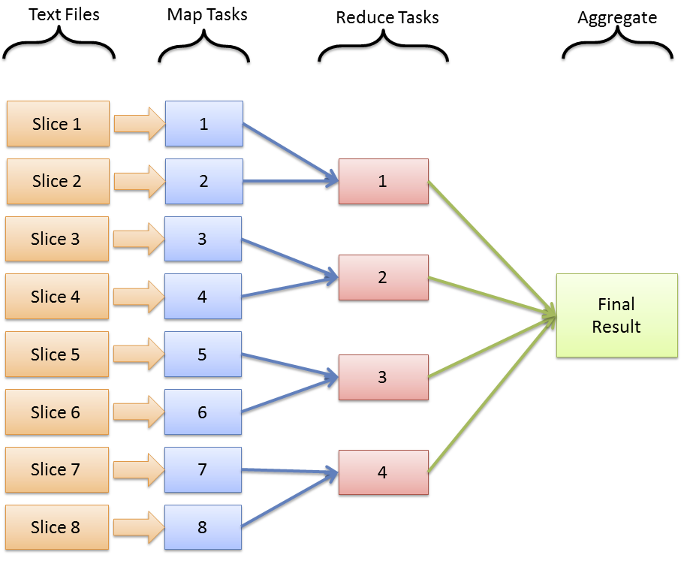
Map >> Reduce
Notes:
MapReduce is a programming model to process and generate large data sets with a parallel and distributed algorithm.
MapReduce is a model derived from functional programming, I believe Lisp, that uses concepts known as the name suggests map and reduce combinators
The map starts at the master node, which takes and divides the input it into smaller inputs and then distributes these smaller entities to other worker nodes for the rest of the process.
The worker nodes could further divide the problem and pass down the data to other worker nodes, thus creating a multilevel tree.

Slide 61
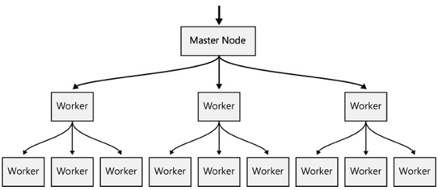
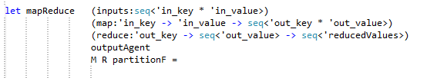
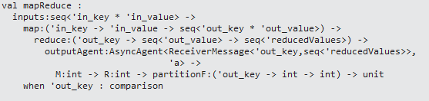
Map >> Reduce
Notes:
The function looks rather complex, but once you understand what is going on, it should become quite clear.
mapReduce takes seven parameters:
- inputs: a sequence of input key/value pairs.
- map: this function operates on each input key/value pair. It returns a sequence of output key/value pairs.
- reduce: this function operates on an output key and all the values associated it.
- ouputAgent: this is the agent that gets notified every time a new output key has been reduced
- M: how many map agents to instantiate
- R: how many reduce agents to instantiate
- partitionF: the partition function used to choose which of the reducers is associated with a key
let partitionF = fun key M -> abs(key.GetHashCode()) % M
Given a key and some buckets, it picks one of the buckets. Its type is: ‘a –> int –> int, so it’s fairly reusable.

Slide 63
THREADING

Slide 64
Threading
Is the smallest unit of processing that can be scheduled by an Operation System…
http://en.wikipedia.ork/wiki/Thread_(computing)
Threads share the memory heap
Threads can communicate by writing to this shared memory
Each Thread receives its own stack space ~1 Mb
Notes:
Modern computers come with multiple processors, each equipped with multiple cores. These logical units allow multiple computations to happen at the same time, so rather than executing your program sequentially, you can take advantage of these extra processors and cores by splitting up your programs
Threads-and-locks programming has many well-understood problems, infact threads can be evil

Slide 65



Threads can be evil!
Spawning multiple threads on a single-CPU~system won’t hurt anything~, but the processor can only execute one of those threads at a time
Spawning new threads can be costly
each thread has its own stack to track
Possible race conditions …and Deadlocks
Hard to stop (Thread.Abort)
Complicated programming model
for synchronization (Mutex, Semaphore…)
Waiting for result?
Notes:
If you spawn a lot of thread can down grade the performance for the time lost switching between the differents threads, and
Each Threads has a stack size ~1Mb, if you run 500 threads … well it is half gig of memory right there.
Also an aborted thread could leave shared state corrupted, could leave asynchronous operations running
waiting for a signal from the operating system. The number of threads in the thread pool is automatically tuned

Slide 66
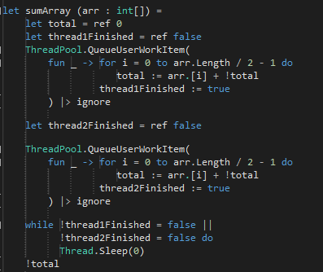
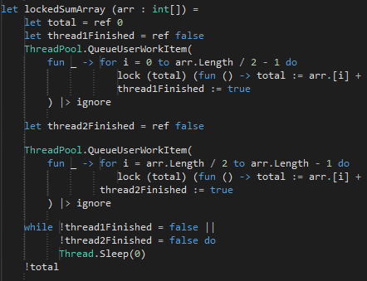
Threading – Race Conditions
A race condition is when you have two threads trying to read or write the same reference at the same time
Notes:
A race condition is when you have two threads trying to read or write the same reference at the same time with the probability to execute
In different state, Locking solves the data race problem …however, it introduces more problems down the road. Deadlock.

Slide 67

Notes:
Deadlock is a danger whenever a thread tries to hold more than one lock.
Deadlocks are when you want to access a resource that is locked by another thread, but that other thread won’t let up until you release a resource that you have locked.
Deadlocking doesn’t mean that sharing data between threads is a no-win situation.

Slide 68
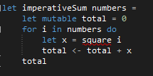
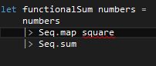
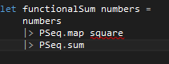
Threading in F#
There are three concepts from the functional world that are essential for parallel computing
declarative programming style
working with immutable data structures
side effect-free functions are important
The code becomes more declarative when using immutable data
Imperative declarative parallel
Notes:
The code becomes more declarative when using immutable data, because the code is more concerned with the expected result of the computation than with the details of copying and changing data. Immutable data structures and side effect-free functions are important, because when code doesn’t contain side effects, we can easily identify which pieces of code don’t depend on each other and determine to run it in parallel.

Slide 69
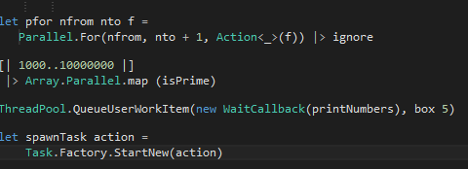
Threading - Full .NET Integration
System.Threading & System.Threading.Task
Parallel Library (TPL) execute tasks (primitive units of work) in parallel
Parallel LINQ (PLINQ) used for writing data parallel code
Reactive Extensions
Notes:
F# can leverage all the .Net ecosystem and it is full integrated with the TPL library
ThreadPool The thread pool consists of two main sets of suspended tasks: a queue containing user work items and a pool of I/O completion callbacks, each waiting for a signal from the operating system. The number of threads in the thread pool is automatically tuned, and items can be either queued asynchronously or registered against a .NET WaitHandle synchronization object”
It uses dynamic work distribution, which means that tasks are divided between worker threads depending on the availability of the threads. Once a thread completes all its own assigned tasks, it can start “stealing” tasks from other threads, so the work will be evenly distributed among all the available processors or cores. The tasks are stored in queues for each worker thread, which also minimizes the needed synchronization and locking in the implementation.
To parallelize the loop, we can use the Parallel.For method. The class is available only on .NET 4.0 and lives in the System.Threading.Tasks namespace. The Parallel.For method takes an Action<int> delegate argument, which we can supply using a lambda function. Using the method directly in F# feels a bit heavyweight, so we’ll define a simple function that makes the code more succinct:

Slide 70

GPU

Slide 71
GPU
Wikipedia defines GPU as follows
A graphics processing unit (GPU), is a specialized electronic circuit designed to rapidly manipulate and alter memory to accelerate the building of images in a frame buffer intended for output to a display. Modern GPUs are very efficient at manipulating computer graphics, and their highly parallel structure makes them more effective than general-purpose CPUs for algorithms where processing of large blocks of data is done in parallel. In a personal computer
Wikipedia defines GPGPU as follows
General-purpose computing on graphics processing units (GPGPU) is the means of using a graphics processing unit (GPU), which typically handles computation only for computer graphics, to perform computation in applications traditionally handled by the central processing unit (CPU). Additionally, the use of multiple graphics cards in one computer, or large numbers of graphics chips, further parallelizes the already parallel nature of graphics processing.
Notes:
The Wikipedia definition
A modern GPU is a powerful data-parallel processor, capable of embarrassing the CPU when used for number-crunching
GPGPU is a practice that is commonly referred to as general-purpose GPU computing.
Modern GPUs are exceptionally sophisticated, they are powerful parallel processors capable of rendering billions of triangles per second, they were originally designed with graphics alone in mind, but today their capabilities can be used for a much wider range of applications.

Slide 72
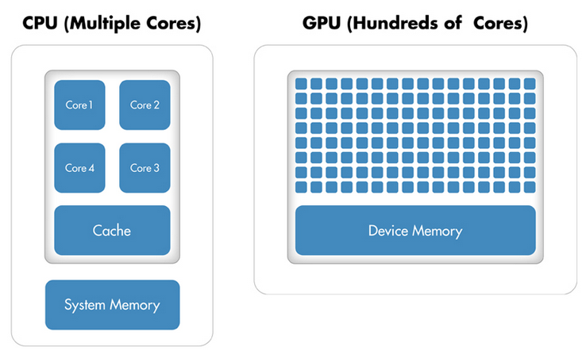

GPU
Notes:
Most developers get excited when their machine has four or eight processors, but that is a drop in the bucket when compared to what the GPU offers.
GPUs generally have tens and even hundreds mini processors
The idea is to use the capabilities of GPU for computations even in non-graphic applications to gain huge speed-ups.
A modern GPU is a powerful data-parallel processor, capable of eclipsing the CPU when used for number-crunching, a practice that is commonly referred to as general-purpose computing on the GPU or GPGPU programming.
Over the years, a number of technologies have emerged to abstract away from the details of GPU implementation. We’ll be using the Open Computing Language, or OpenCL, to write GPGPU code
Think to have a supercomputer hidden inside your laptop.

Slide 73

GPU – MSFT Accelerator
Microsoft Accelerator
The project Microsoft Research Accelerator is a .Net library for developing array-based computations and executing them in parallel on multi-core CPU or more interestingly, using GPU shaders
Accelerator handles all the details of parallelizing and running the computation on the selected target processor, including GPUs and multicore CPUs
Notes:
Microsoft Accelerator provides a great way for applications to implement array-processing operations using the parallel capabilities.
I really like the approach of this library and how easy it is to use, you can write very easily code that can be execute on GPU and/or multicore processors.

Slide 74
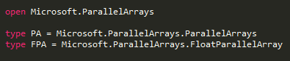
GPU – Accelerator Usage
FPA type represents a computation that returns an array of floats
PA type represents the static class which contains operations for working with computations
Notes:
To use Accelerator first of all, we'll need to add reference to the Microsoft.Accelerator.dll assembly. This is just a managed wrapper for a native library that also needs to be copied to the output directory, then import the namespace.
Usually is good practice leverage the F# type system to define some abbreviations for the types of Accelerator.
In this example
The FPA type represents a computation that returns an array of floats when executed.
The PA type represents the static class which contains operations for working with these computations.

Slide 75
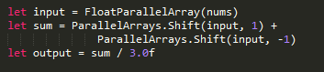
GPU – Accelerator Usage
Accelerator library exposes various types for creating data-parallel computations.
FloatParallelArray represents a computation that returns a 1D array of floats
Shift method moves elements of the array to the left or to the right

Slide 76
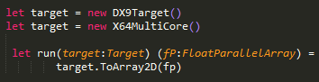
GPU – Accelerator Usage
DX9Target performs data-parallel operations using shaders on your GPU
(massively parallel)
X64MultiCore performs data-parallel operations using multi-core 64bit CPU.
Notes:
When writing code to execute, we're not actually running any computations yet!
The type represents a computation and doesn't perform.
The computation is executed later when we create a target type that knows how to perform the operations.
To run the computation we initialize a target type that could be DX9Target, which executes computations using GPU, or a X64Multicore type to run the operation using multi-core CPU
(but note that this works only on x64).
~~~~~~~~~~~~~~
DX9Target performs data-parallel operations using shaders on your GPU. This is massively parallel, however there are some initial costs associated with copying data to the GPU memory and back.
X64MultiCore performs data-parallel operations using multi-core 64bit CPU. This is using highly optimized native implementation.

Slide 77
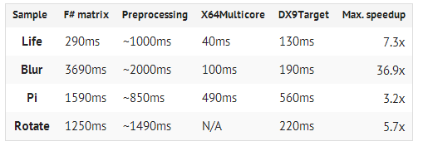
GPU – MSFT Accelerator
Notes:
These are tests run on a laptop, some of the results are quite impressive!

Slide 79
Stm

Slide 80


Software Transactional Memory
Notes:
Software Transactional Memory (STM) is an approach for solving the concurrency problems associated with shared state.
In fact STM avoids the use of traditional, error-prone locks to control the access to shared memory.
What do I mean with is that using STM, Instead of traditional locks we can specify a section of code that will make atomic changes to shared memory.
One of the benefits of STM is that it allows us to make concurrent and coordinated changes to multiple variables.
In theory STM works just like transactions in a database. In fact a memory transaction is a unit of work that either completes entirety or has no effect at all.
As the ACID in the Database Transaction, STM is atomic, consistent, and isolated… but not durable of course.
~~~~~Transactional memory is intended to make programming with threads simpler, in particular synchronizing access to data shared between several threads using transactions.
Ideally different threads cannot try to modify the same piece of data at the same time, dirty reads are not possible, and deadlocks are automatically detected and handled.
Of course this also leads to the same issues such as questions about optimistic versus pessimistic locking, lock granularity, and the performance impact.
There is an Hardware Transactional Memory (HTM) system uses multi-word synchronization operations of the CPU to implement the requirements of the transaction directly
Atomic:
From the point of view of code running in another transaction, either all of the side effects of a transaction take place, or none of them do.
Consistent:
Transactions guarantee preservation of invariants specified through validators (like those we’ve already seen for atoms and agents). If any of the changes attempted by a transaction fail to validate, none of the changes will be made.
Isolated:
Although multiple transactions can execute concurrently, the effect of concurrent transactions will be indistinguishable from those transactions running sequentially.
You may recognize these as the first three of the ACID properties supported by many databases. The missing property is durability—STM data will not survive power loss or crashes. If you need durability, you need to use a database.”

Slide 81

Software Transactional Memory
Notes:
I borrowed the STM implementation from the FsharpX library,
In this implementation the F# monadic interface defines the monad type Stm<’T> with a corresponding builder class to enable computation expression syntax.
The advantage of using computation expressions is that the transaction log is explicitly passed between functions.
The main idea is that a block of code including nested calls, can be enclosed by an atomic block with the guarantee that it runs atomically using any locks.
~~~~~~Gregory Neverov created a monad to bring this functionality to F#. In addition to the source for the STM monad, this library includes an ArrayQueue and ListQueue that are built on top of the STM monad.
An atomic block runs accumulating a thread-local transaction log that records every memory read & write
An issue with the implementation of STM systems is how to access the transaction log to make reads and writes during a transaction. Two common approachs are to use thread-local storage which is slow, or implicitly pass the transaction log as an extra parameter to every function, which requires code generation.
.

Slide 82

Software Transactional Memory
Hardly Successful
Notes:
An STM program is always going to be slower than a lock-based program, and in past any attempt to build an STM have been a failure.
The design and implementation of this STM F# library is coming from the Microsoft paper Composable Memory Transactions,
it was engineered for correctness and design of the monadic interface and has really bad performance.
The main problem is that there isn’t support baked in the framework in the first place.
~~~~Mr. Joe Duffy, architect and Soft leader of the MSFT TPL library, sfinal reason for being disillusioned with software transactional memory is the lack of any real successes.
Most forms of I/O are inherently non-transactional, and as distributed computing becomes more popular, the problems become more unavoidable
successes in the latter, I became less and less convinced that the killer concurrency apps we will see broadly deployed in the next 5 years needed TM. Most enjoyed natural isolation, like embarrassingly parallel image processing apps. If you had sharing, you were doing something wrong.

Slide 84
Summary
Immutability and Isolation are your best friends to write concurrent application
Use natural isolation, the Actor model is a great to enforce coarse-grained isolation through message-passing
Asynchronous Programing in F# is easy and declarative
Concurrency in F# is fully integrated with .NET
Use Actor Model for high scalable computation
Notes:
Actor programming is one of the most widely applicable programming models
not only does it provide support for concurrency, but it also provides distribution, error detection, and fault tolerance.
It provides immutability and isolation which are the more important characteristic to write good and bug free concurrent program

Slide 85
Q & A ?
The tools we use have a profound (and devious!) influence on our thinking habits, and, therefore, on our thinking abilities.
-- Edsger Dijkstra

Slide 86

github.com/DCFsharp meetup.com/DC-fsharp/ @DCFsharp rterrell@microsoft.com

